Slide 1
The Story Of the Mean Greenhouse Gases
Notes:
Title: The Story of the Mean Greenhouse Gases

Slide 2
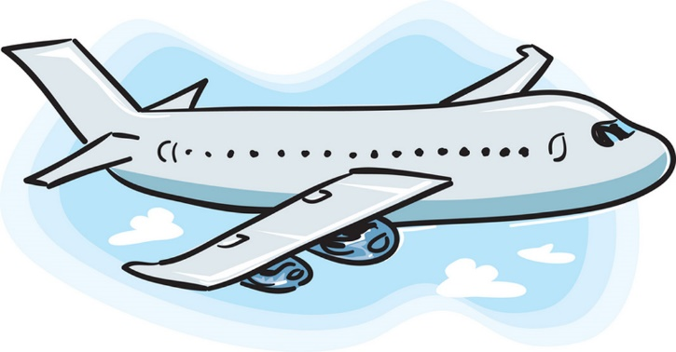
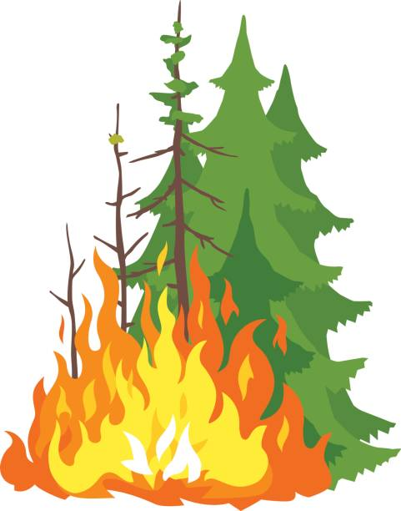
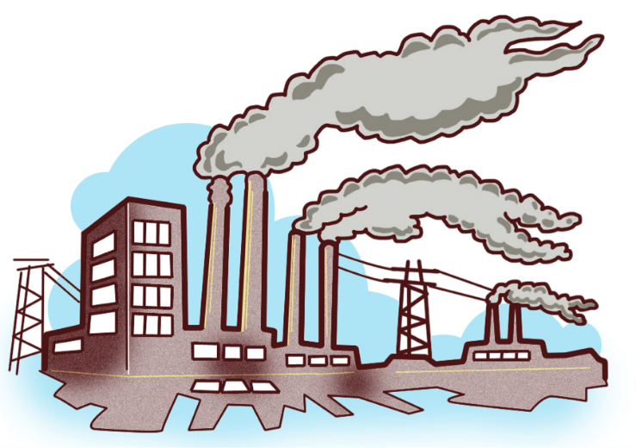
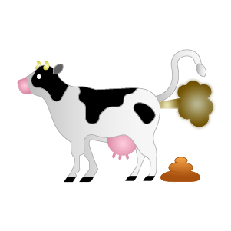
Notes:
Greenhouse gases are mean little gasses that float out of cars, cows, trains, smoke stacks, and burning trees (deforestation).

Slide 3
Notes:
These mean greenhouse gases destroy our atmosphere by rising up in the sky.

Slide 4
Notes:
They surround our earth like this.

Slide 5
Notes:
(click)* (click) (click) So when the sun’s rays shine down on earth, (click) some of that heat from the sun escapes back into space, (click) (click) while some of the heat gets trapped by the mean greenhouse gases, and are unable to escape, (click) so the heat goes back down to earth.
* Left click on your mouse

Slide 6
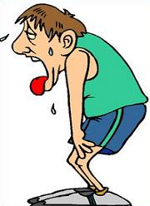
Notes:
So because the heat is trapped our earth gets warmer.

Slide 7
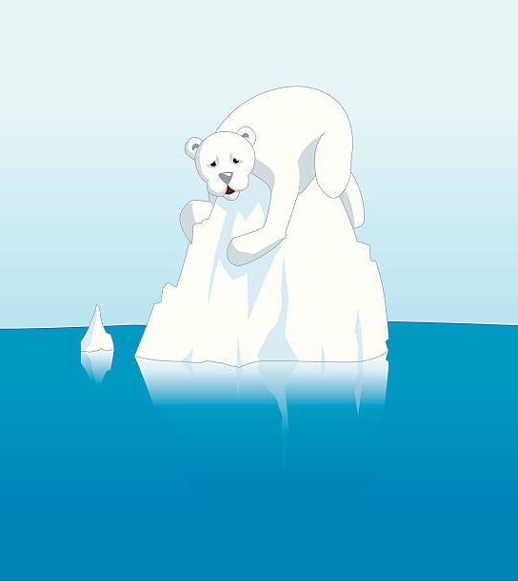
Notes:
These warmer temperatures lead to ice melt in places like the Arctic and Greenland where it is supposed to be really cold. When the ice starts to melt this means less chance for animals to survive. Also, more places will be experiencing less rainfall which can affect plant growth.

Slide 8
What Can You Do?
Notes:
But what can you do about this? Good news there is a lot you can do! Let’s put your knowledge to the test with this quiz! If you guess most of the questions right you will be well on your way to becoming a hero for our environment!

Slide 9
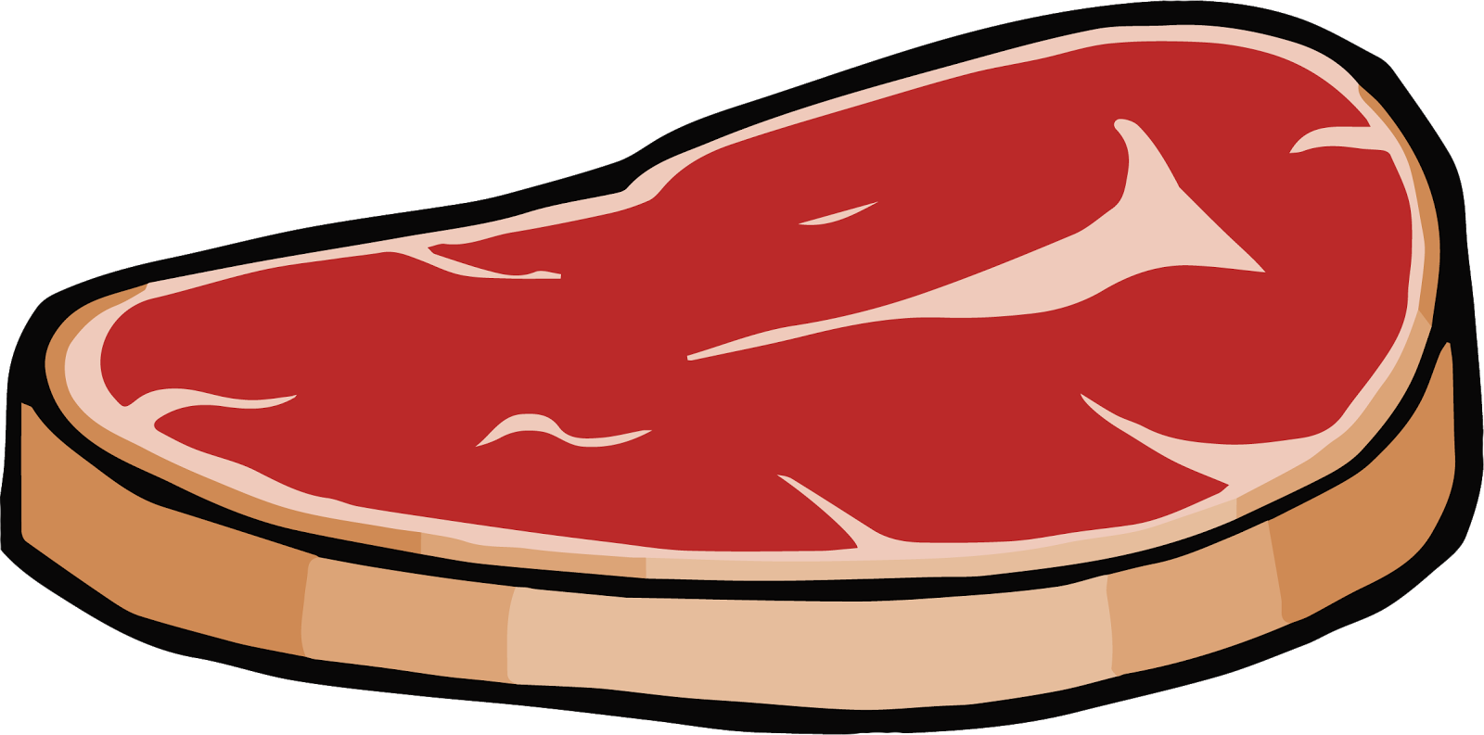
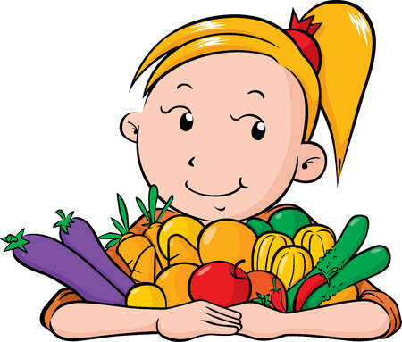
Meat or Veggies
Notes:
Which food item do you eat to help save our environment?
Clue: Cows release a gas called methane gas from burping and farting because of the food we are feeding them(corn and soy).
Correct! Veggies are the better option because cows release those mean greenhouse gases, so it’s better not to eat meat to stop those greenhouse gases from warming our earth!

Slide 10
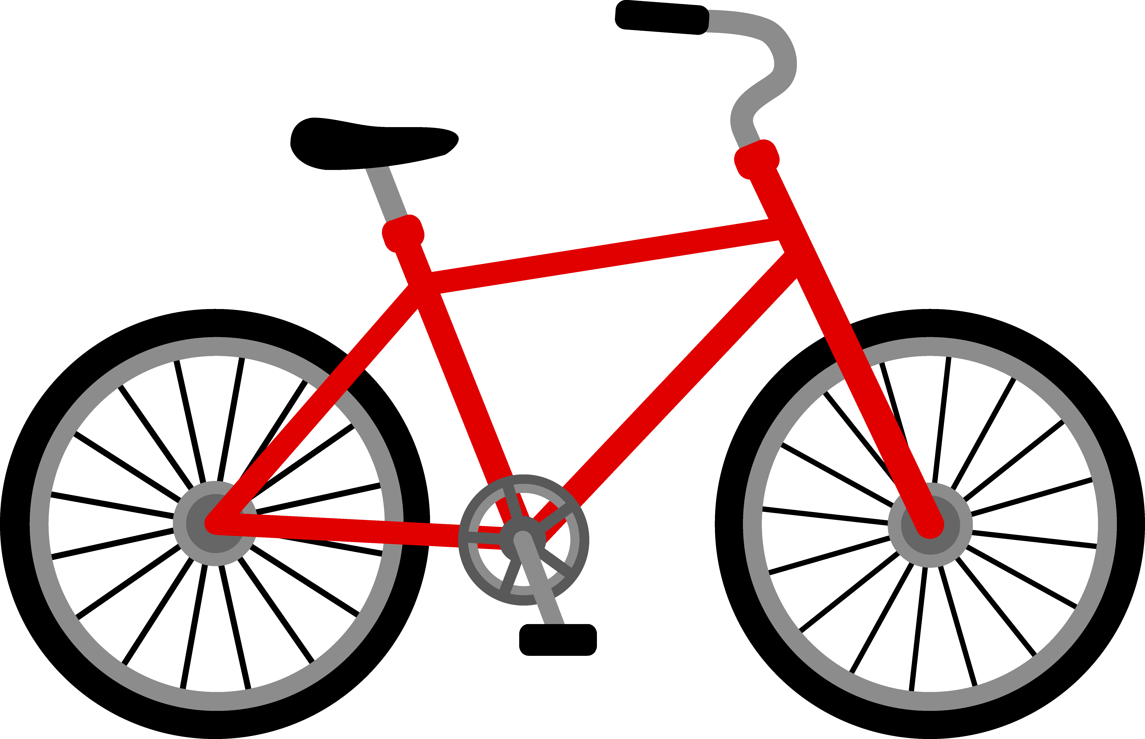
Car Ride or Bike Ride
Notes:
Which is the better option, riding in the car or bike riding?
Clue: Cars release a gas called carbon dioxide which can be harmful to our environment.
Correct! Cars release those mean greenhouse gases that pollute our earth so riding your bike is definitely the best option, plus you get some fresh air and exercise too!

Slide 11
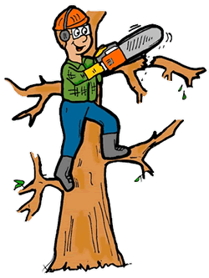
Plant Trees or Cut Down Trees
Notes:
Which is the better option, tree planting or cutting down trees?
Clue: Trees take in in a gas called carbon dioxide (CO2) and when we cut down trees that gets released back into the air.
Correct! Planting trees is the better option and more fun! Trees help clean our air by taking in carbon dioxide (CO2) which is that mean greenhouse gas, so when we cut down trees it just releases all those mean greenhouse gases back into the air.

Slide 12
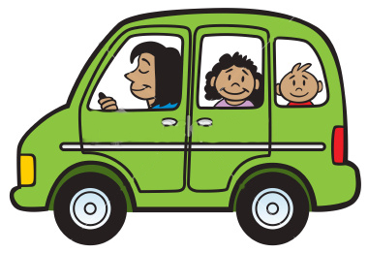
Carpool or One Person
Notes:
Which is the better option, carpooling or only with you in the car?
Clue: Cars release a gas called carbon dioxide (CO2) which can be harmful to our environment.
Correct! Carpooling with a friend is the better option! Cars release those mean greenhouse gases into the air so carpooling can minimize the amount of cars on the road which will minimize the gases being released into the air!

Slide 13
Turn Lights or Keep Lights Off On
Notes:
Which is the better option, turning your lights off or keeping them on when you are not in the room?
Clue: Energy gets used up when we keep our lights on. And a lot of times that energy is coming from oil, coal, or natural gas.
Correct! When we keep our lights on it uses up a lot of energy, and that energy may come from oil, coal or natural gas, so when we use energy those mean greenhouse gases are being released. It’s always better to remember to turn off your lights when leaving your room!

