Slide 1
This Not That
Which is the better option for the environment?

Slide 2
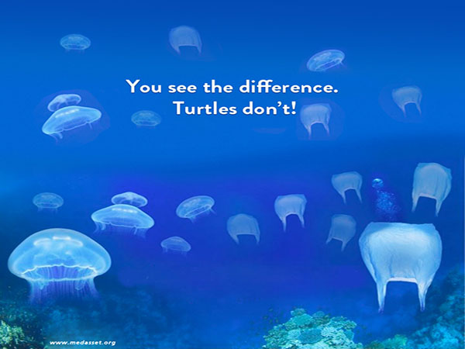
Protect our sea life by saying no to plastic!
Notes:
Turtles eat jelly fish and plastic bags look like jelly fish, so when plastic bags are floating in the water it confuses the turtles, so the turtles eat the plastic, thinking it is jellyfish.
Credit:
http://www.bonaireturtles.org/wp/kids-page/

Slide 3
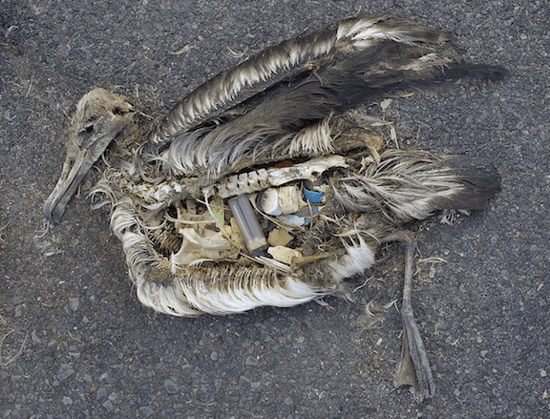
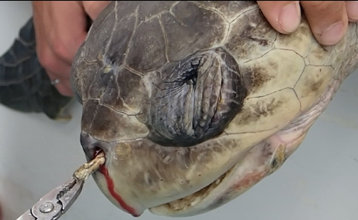
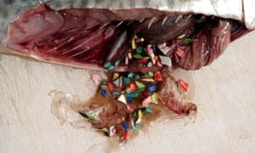
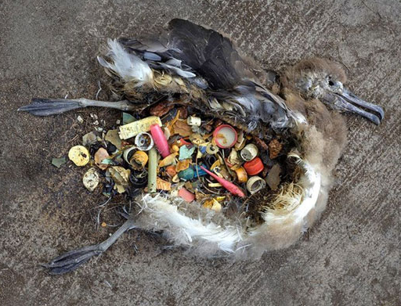
Notes:
Photos of pieces of plastic found in sea bird bellies and fish bellies. Also, a picture of a turtle with a plastic straw stuck in the nose.

Slide 4
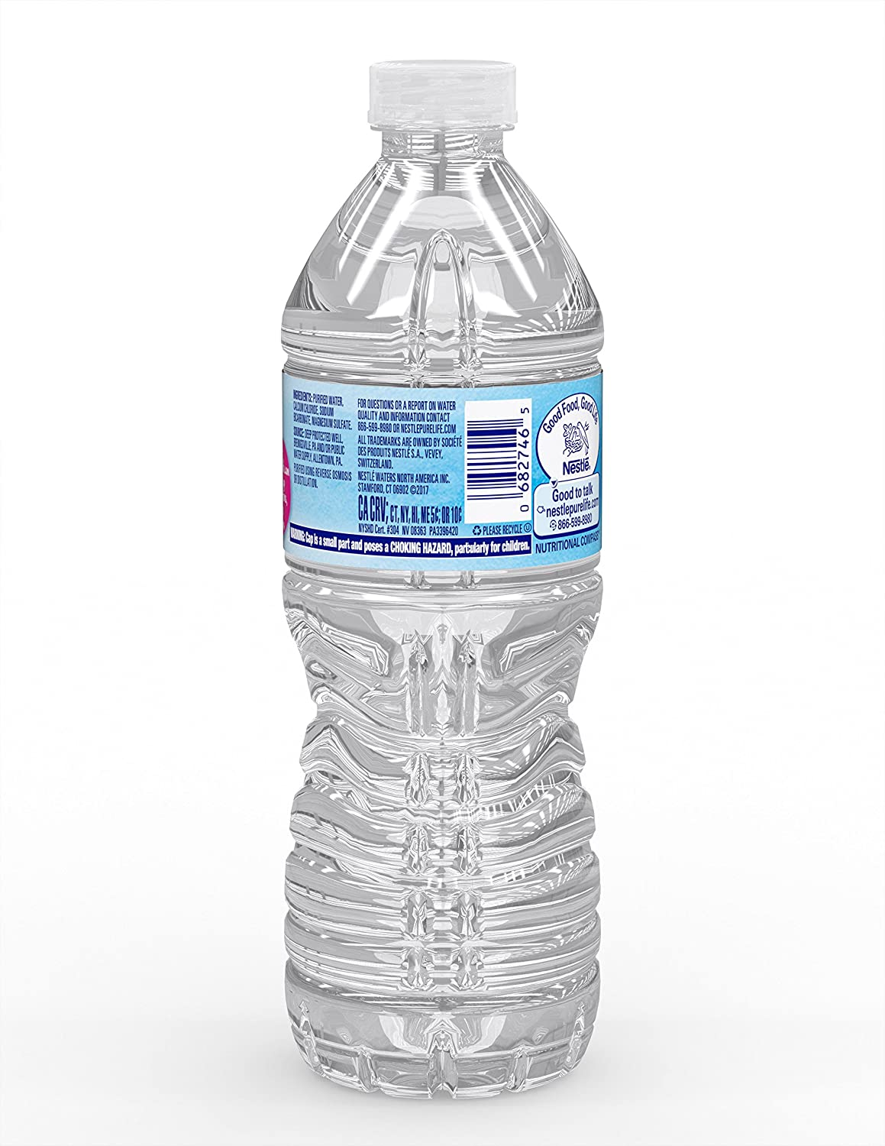
Reusable Plastic Bottle Vs. Bottle

Slide 5
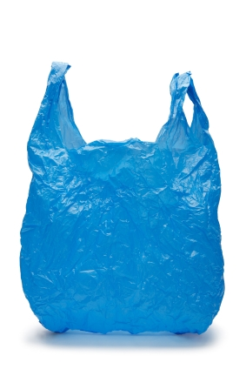
Reusable Plastic Bag Vs. Bag

Slide 6
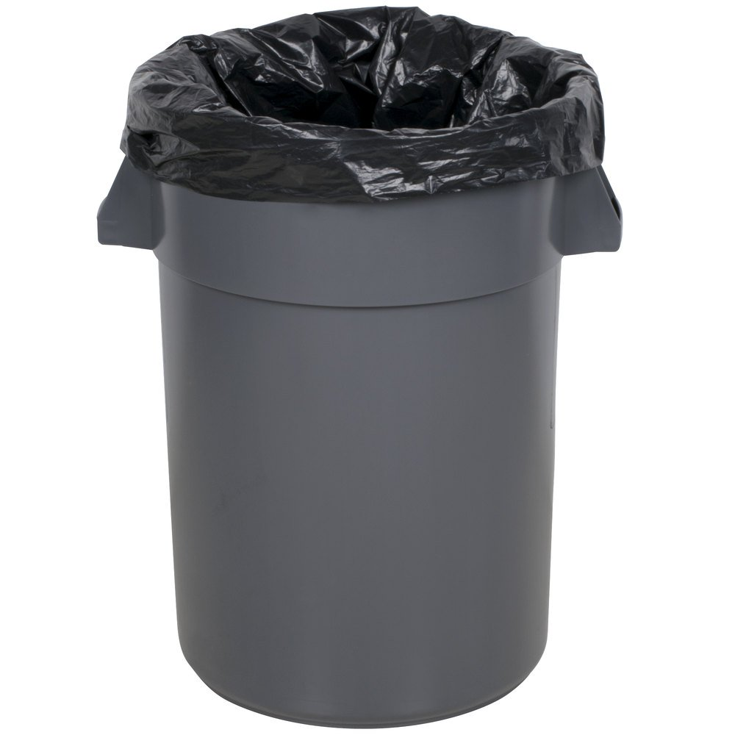
Donate used Throw away clothing Vs. clothes

Slide 7
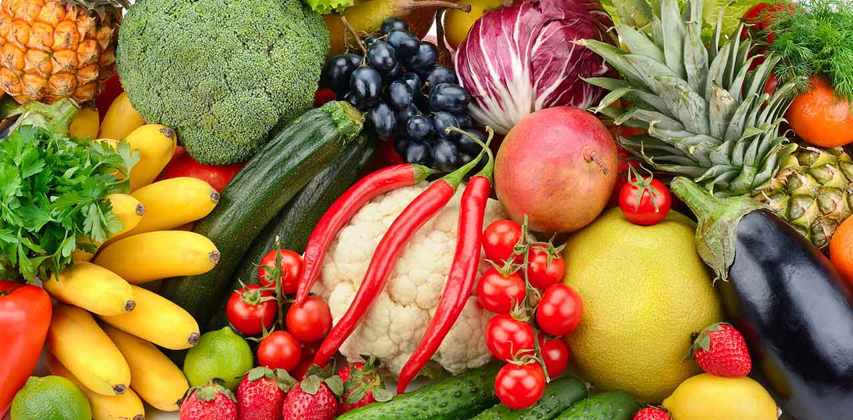
Packaged unpackaged Fruit/Veggies vs. Fruit/veggies

Slide 8
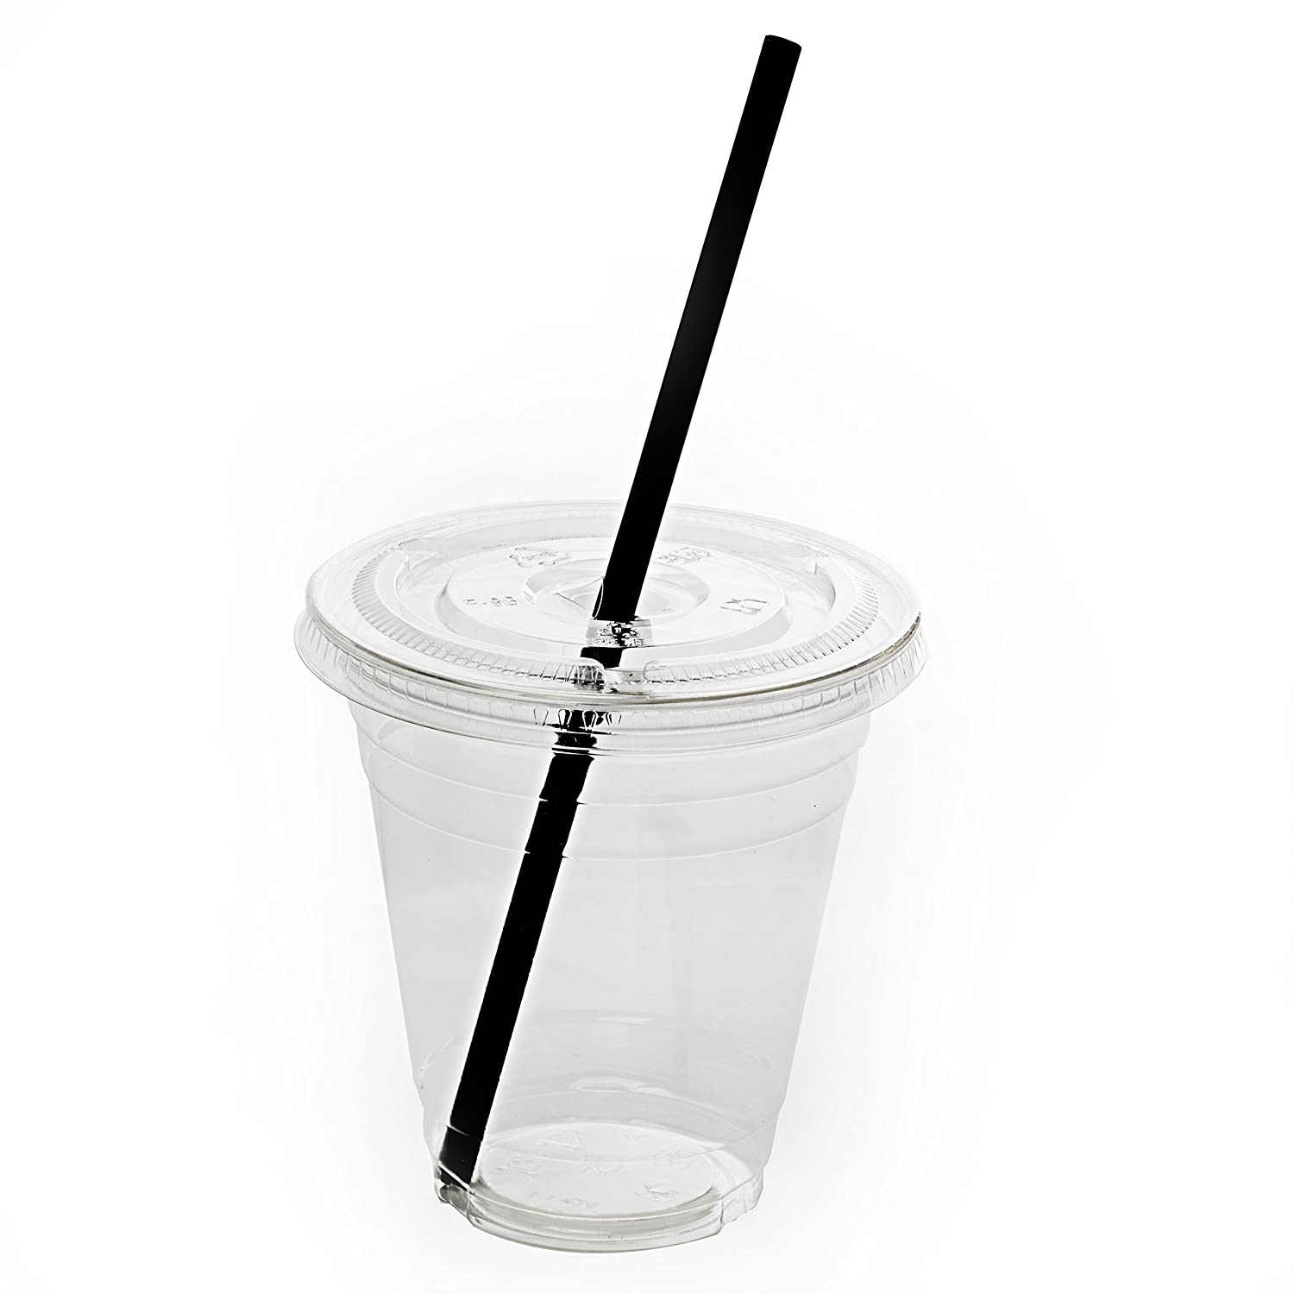
Metal Plastic straw vs. straw

Slide 9
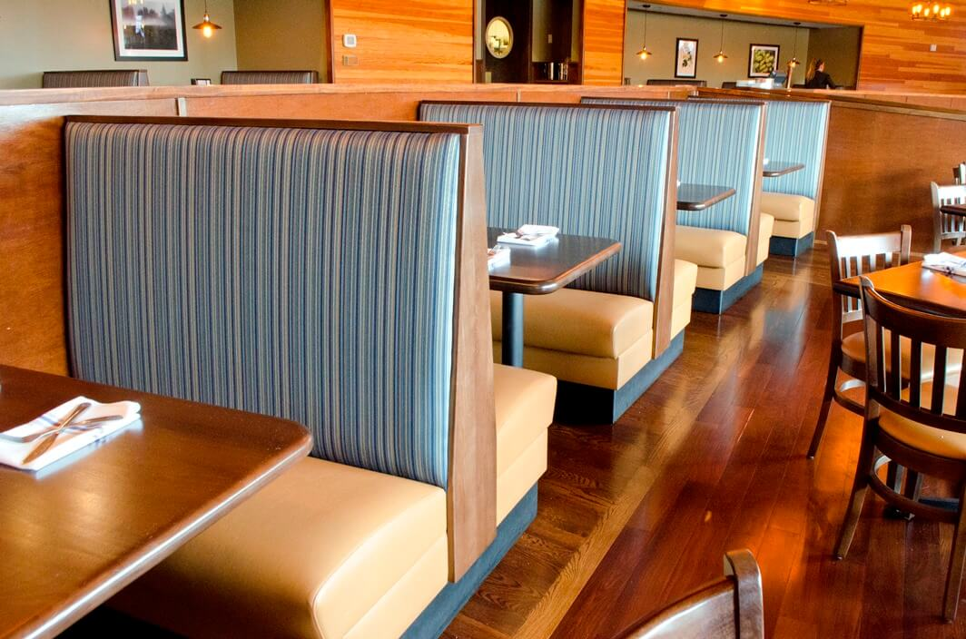
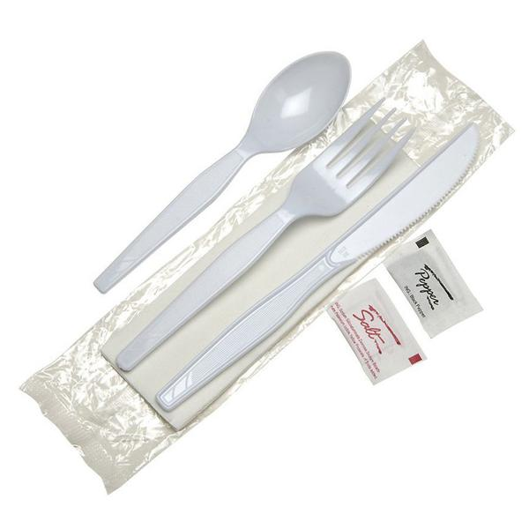
Eating to-go Vs. Eating at the Restaurant

Slide 10
Donate Throw Toys Toys Vs. Away

Slide 11
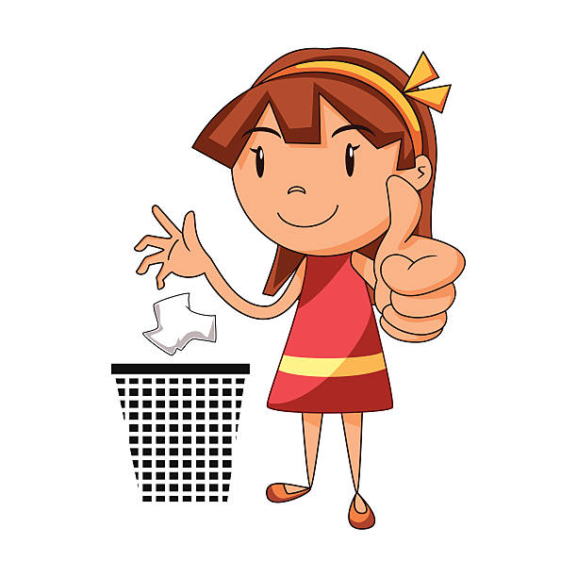
Litter vs. Pick up trash

